Slide 1
OPTICAL CHARACTER RECOGNITION
(Developing New Set of Characters Optically Identifiable By Machine)

Slide 2
MOTIVATION BEHIND THE PROJECT
About 2 Billion people in the world use the English alphabets on a daily basis (….thanks to colonization....). In this modern age, we felt the need of a mechanical way to make machines recognize these alphabets and provide us a more efficient and time saving lifestyle. For example- The CTS system in a bank sanctions hundreds of cheques per hour depending on the limit of user, type of cheque etc. Now imagine the time and effort it will take if a person has to type and enter the amount on each cheque one by one into the computer. So if a machine can recognize these amounts and other details automatically, it will save a lot of manual resources with minimal chances of error.

Slide 3
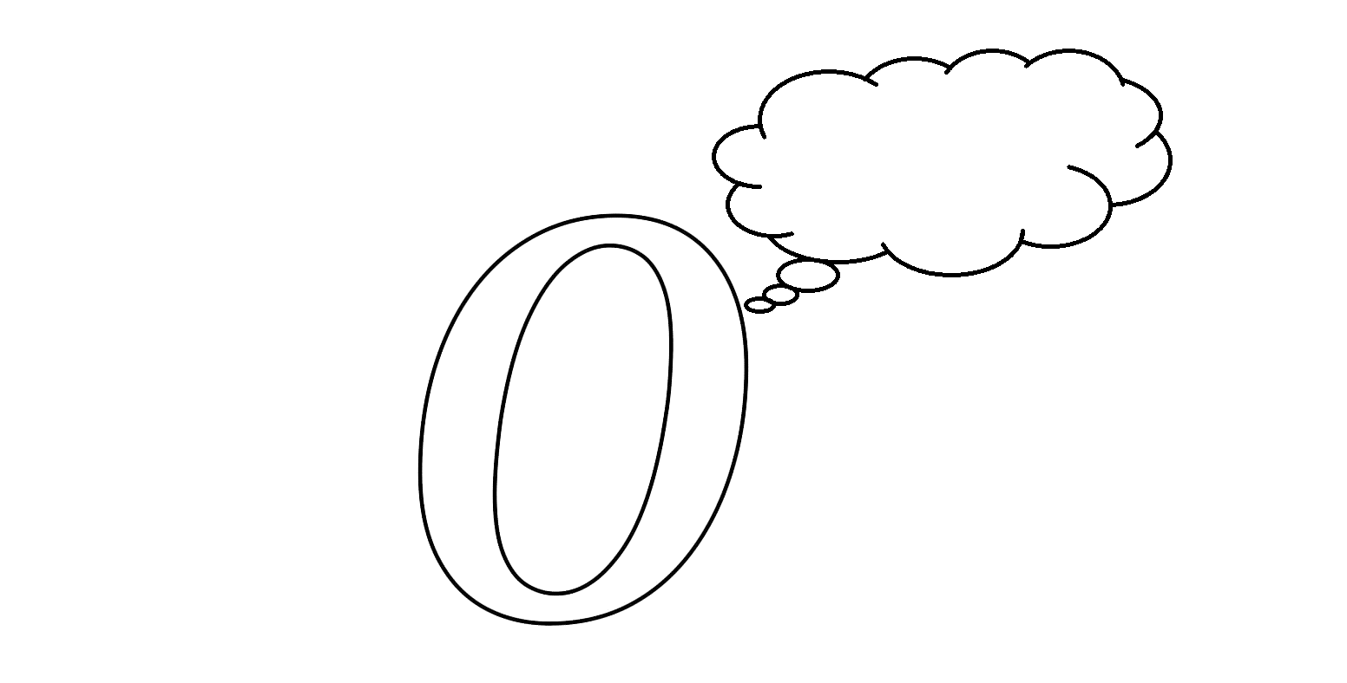
MOTIVATION BEHIND THE PROJECT
.
However, the English alphabets and for that matter any other characters or symbols were created without the priority of being easily recognizable by a machine! It requires a lot of complex algorithms like neural networks, and unsupervised learning to recognize the English alphabet . So, we decided to create our own characters which can be easily recognized by the machine and are easy to write ,use these characters to work with their respective English alphabets, numbers ,etc.
I am UNSCANNABLE

Slide 4
PROBLEM STATEMENT
The problem consists of designing a class of alphabets with rules for extension that can be easily recognized by the computer and are easy to write. This new set of alphabets should be resilient to stray dots and lines and small pixel gaps. The time complexity to recognize the letters should be reasonable. Ideally, the algorithm should be able to do its job at minimum space and time constraints even when the text is produced in a moving vehicle.

Slide 5
PROPOSED ALPHABETS......

Slide 6
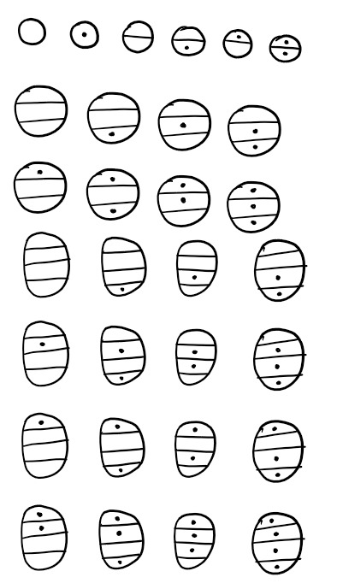
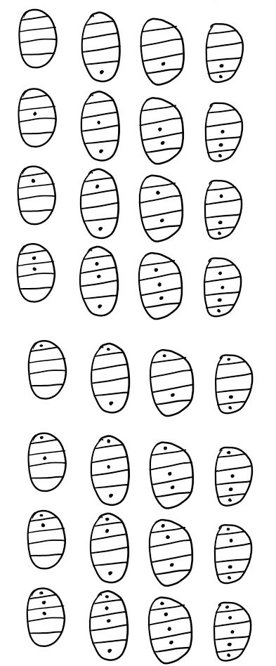

Slide 7
MORE ABOUT CHARACTERS......
We found out that if we can make out characters with identifiers such as bounded regions and the presence or absence of blobs in a particular bounded region, then that can be easily recognized by our machine. So we can easily distinguish the characters and can map them to our desired alphabets, digits and special characters as per our own needs. For the sake of simplicity of writing, it is beneficial to assign frequently occurring characters to simpler symbols.

Slide 8

CHARACTERISTICS AND EXTENSION......
This is one of our created characters. The character is essentially an ellipse which is divided into many regions by some (not necessarily straight) lines. There is also a rather prominent blob in the downmost region.
We can keep on increasing the number of regions to assign further new symbols if required. Each chamber gives rise to 2 different pat-terns. Hence, n regions will give rise to 2^n different patterns. So, if we take maximum 6 chambers, we can get as many as 2^7 – 2 = 126 many characters.

Slide 9
DBSCAN IS THE ONLY WAY.....
DBSCAN categorizes points into three main categories: core points, border points, and noise points. Core points are those with a sufficient number of neighboring points within a specified radius, while border points lie within the neighborhood of a core point but lack enough neighbors to be considered core themselves. Points that do not fall into either category are labeled as noise points or outliers. The algorithm proceeds by iteratively exploring the dataset, forming clusters around core points and including border points within these clusters. Through this process, DBSCAN effectively delineates clusters while filtering out noise. DBSCAN offers a robust and efficient approach to cluster data where number of clusters is not known beforehand.

Slide 10

RECOGNITION OF LETTERS....

Slide 11
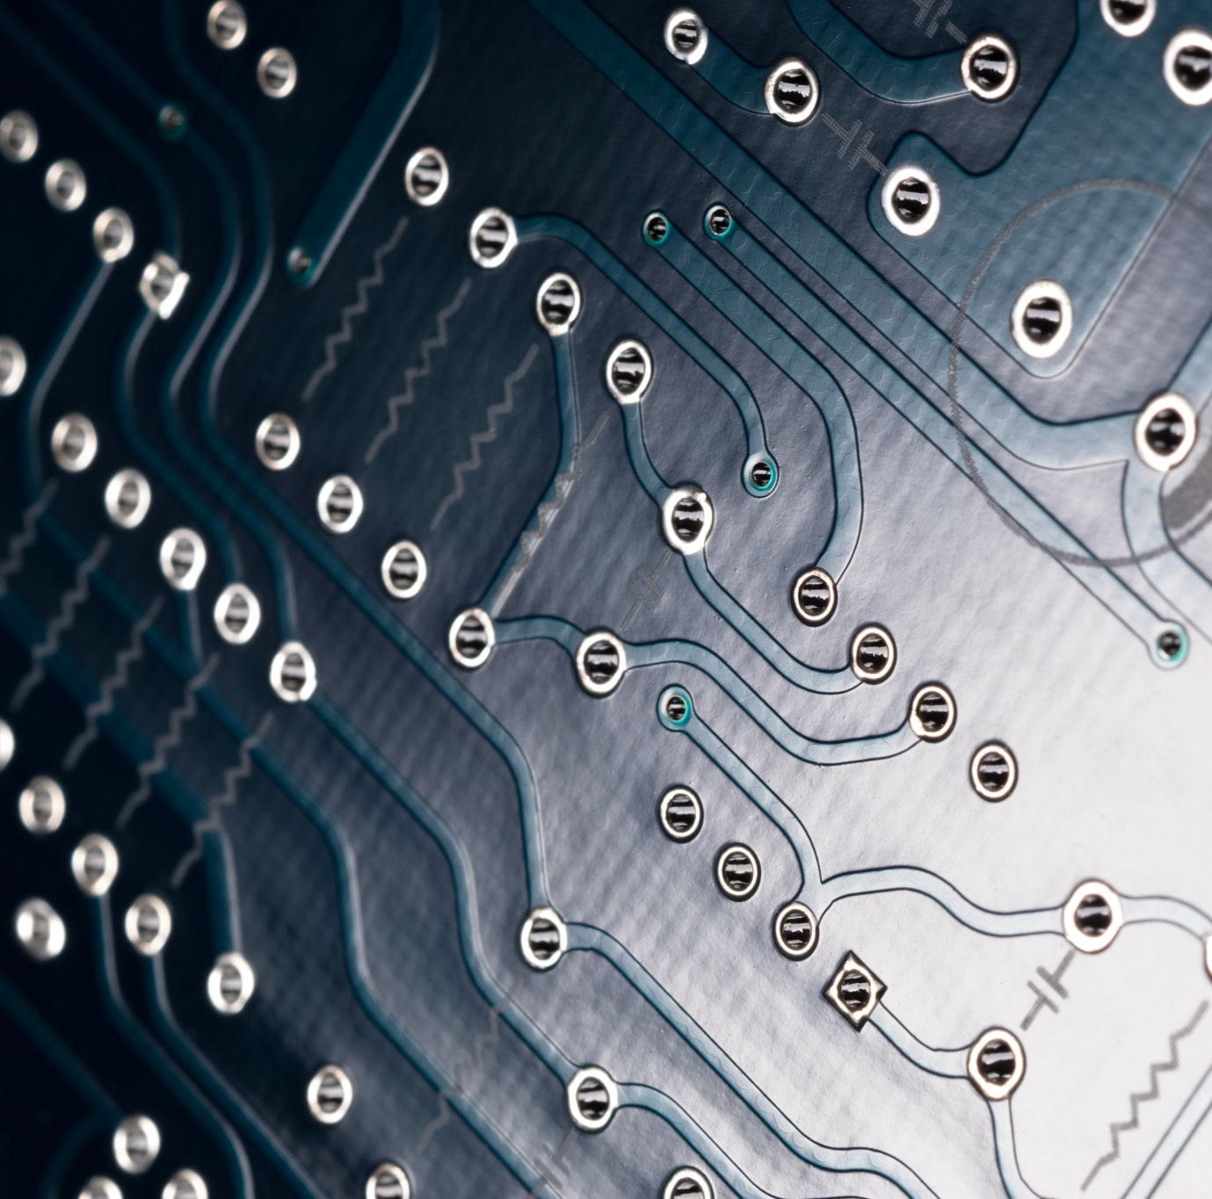
A little about Connected component labelling (CCL)
The input image is typically a binary image, where each pixel is either foreground (1 or white) or background (0 or black). After grey-scaling the image, any pixel with grayscale value less than 145 was made 0 and the remaining was made 1.
Each pixel in the input binary image is assigned a unique label. This labelling process starts from 1 and proceeds sequentially. A data structure is initialized to store the labels assigned to each pixel.
The image is scanned pixel by pixel to identify connected components. The scanning process follows a predefined left-to-right and top-to-bottom order, to ensure consistency.
For each foreground pixel encountered during the scan, If the pixel has no labelled neighbours (i.e., it's not adjacent to any other labelled pixel), a new label is assigned to it. If the pixel has labelled neighbours, it inherits the label of the neighbour with the minimum label value. This step ensures that all pixels within the same connected component share the same label.
As the algorithm progresses, it may encounter situations where different labels are assigned to pixels belonging to the same connected component. To ensure consistency, label equivalence is enforced by maintaining a data structure (e.g., disjoint-set data structure or union-find algorithm) that tracks equivalent labels. Whenever two labels are found to be equivalent, they are merged into a single label.

Slide 12
RECOGNITION OF LETTERS....
We make the use of this Connected Component Labelling(CCL) in our algorithm, our idea is to partition the image into connected components, where pixels within the same component are connected through adjacency. We have the following algorithms
Count Filled Circles Per Region
Create Tuples from Images
Convert to Letters
Process Images

Slide 13
Count Filled Circles Per Region
This algorithm is designed to identify and quantify filled circles within different regions of an image. Initially, we process an image where various regions have been distinguished and assigned unique labels. We the examine each labelled region individually. We determine the size of each region by calculating its area, which is the amount of space each labelled region is occupying in the image. If a region surpasses a certain threshold size (like 100 pixels), we proceed to further analysis.
Now in each region, we isolate the connected components to search for the presence of blobs. For every blob that we find, we assess its relative proportion of the total region area. Any component which overcomes a certain threshold (say, 0.001), is considered to represent a filled circle otherwise it may respond to accidental dots in the characters. We aggregate the counts of filled circles across all regions and return this information.

Slide 14
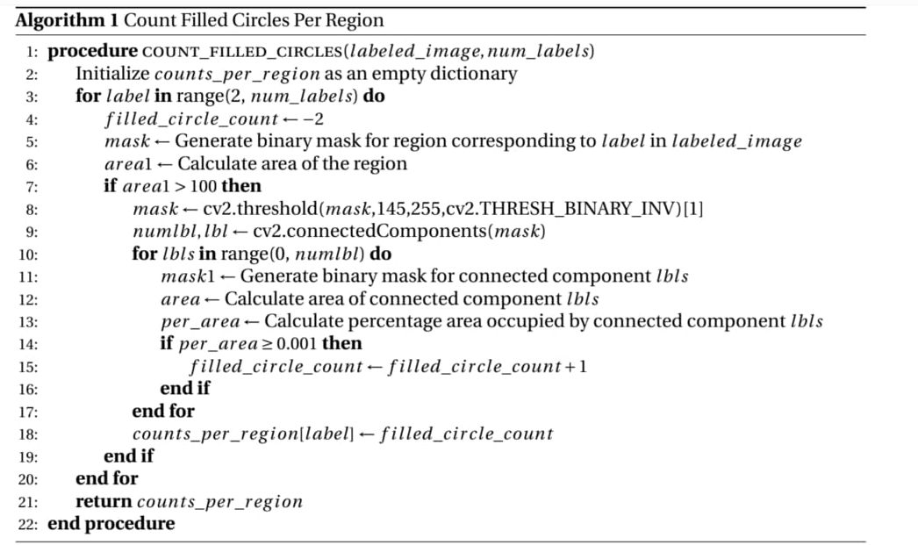
Count Filled Circles Per Region

Slide 15
Create Tuples from Images
This is the step where we filter out the key information from the image. Initially, we prepare an empty list to store this information. Then, using connected component labelling, we identify distinct regions or objects within the image. For each of these regions, we determine the count of filled circles present. If a region contains at least one filled circle, we add this count to our list of information. Finally, we return this list, providing a summary of the filled circle counts across different regions of the image.

Slide 16
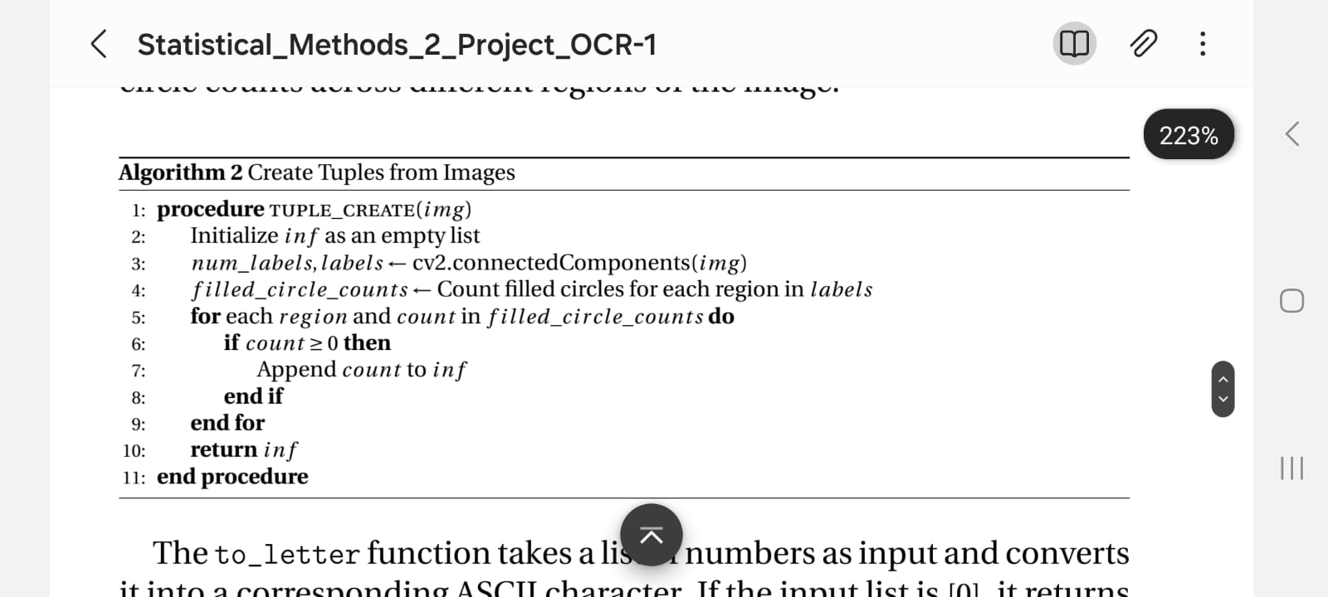
Create Tuples from Images

Slide 17
Convert to Letters
This function takes a list of numbers as input and converts it into a corresponding ASCII character. If the input list is [0], it returns a space character. For other lists, it interprets them as binary numbers, calculates their decimal equivalent, and converts it to the corresponding ASCII character. If the resulting ASCII value is less than or equal to 32 (non-printable range), it adjusts it accordingly before returning the character.

Slide 18
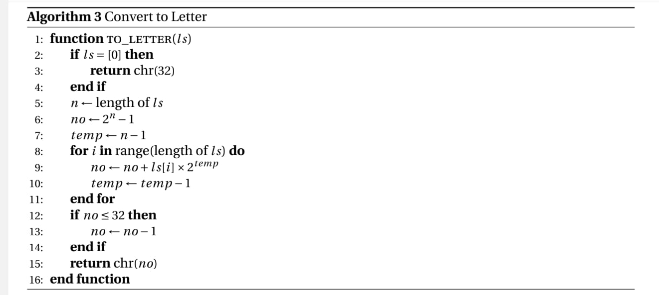
Convert to Letters

Slide 19
Process Images
This function takes an image path as input, opens the image, and converts it into a binary format using a threshold value of 145. It then saves the binarized image and opens it again. Next, it performs clustering on the binarized image, extracting distinct regions. For each region, it converts it to grayscale, applies thresholding again, and generates a list of tuples representing the filled circles within the region. These tuples are converted into letters using the to-ltter algorithm. The resulting letters are concatenated into a string and returned.

Slide 20
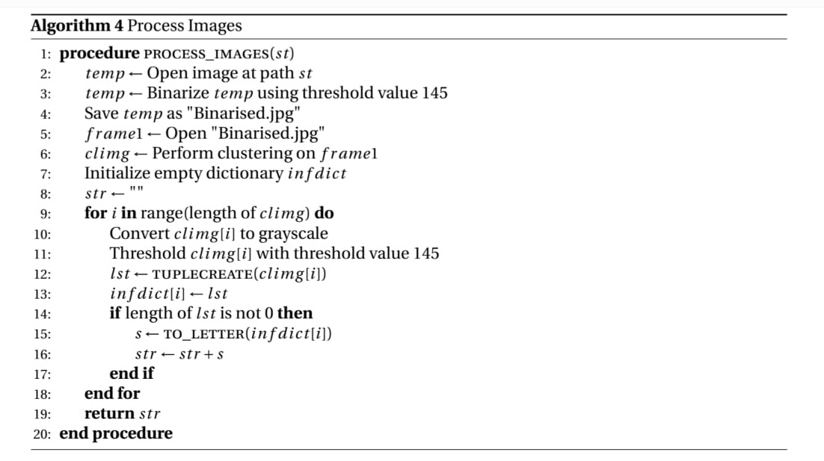
Process Images

Slide 21
THRESHOLD DISCUSSION
As this is a real life scenario, the thresholds vary a lot. So, we have cleverly substituted values in some cases to the best of our knowledge and in other cases, we have used experimental results and tried to minimise the error. Both the above scenarios have resulted in some limitations and ways to avoid them that we will discuss later.

Slide 22
BINARY IMAGE THRESHOLD
Our algorithm for OCR requires us to convert the original image into a binarized image of only 0 (or black) and 1 (or white). To do so, we need a threshold value such that anything below the threshold is made 0 and anything above it is changed to 1. Now, we have experimented with 8 data sets and have found that 145 serves as a good value for this threshold and the binarized image so produced is quite favorable to us.

Slide 23
DBSCAN THRESHOLD
DBSCAN has two parameters - minimum number of points and epsilon.
As it is difficult to handle two parameters, we fix one of them (minimum number of points= 1). Now, we have to set epsilon such that in a particular symbol, every pixel has minimum 1 pixel as its epsilon Neighbour and no two pixels belonging to two different characters have less than epsilon distance between them.
We have observed that an epsilon value of 7.5 works optimally for the data sets that we have obtained.

Slide 24
CONNECTED COMPONENTS
In order to recognise the characters, we use two area thresholds. the first area threshold ensures that any connected component (or mask) has a minimum area before being recognised as a letter. This ensures that any careless gaps in the blobs made by the user does not affect the outcome. After experimentation with over 100 characters, we decided to use 100 square pixels as a threshold in this case.
We use our second area threshold to give a lower bound on the area of the blobs drawn by the user. To negate the effects of the dimensions of the picture, we use the proportional area between those of the blobs and the entire label. We have observed that the value 0.001 serves as a good threshold in most of the cases and hence agreed to move on with it.

Slide 25
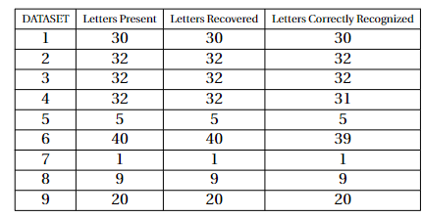
EXPERIMENTAL RESULTS....
We carried out our algorithm on a number of dataset containing our characters. The results are very much to our liking that tells us our process is quite efficient.

Slide 26
The Errors:
Type-1 error: We define Type-1 Error as the erroneous results produced during execution as a result of the non-recovery of characters from the image due to the failure of the clustering algorithm.
We give a mathematical formula for the Type-1 Error produced by our code :-
(number of letters not recovered / total number of letters) x 100
As observed from the above table where we experimented on 8 datasets, we get our Type-1 Error as 0/201 × 100 = 0%

Slide 27
The Errors:
Reason behind Type-1 Errors:
If the user is used to writing the letters quite close to each other and in the process does not abide by the 7.5 pixels gap requirement, the clustering algorithm may fail and cause the two closely spaced characters to be recognised as one single character which leads to errors.

Slide 28
The Errors:
Type-2 error: We define Type-2 Error as the erroneous results produced during execution as a result of incorrect recognition of characters from the image due to the failure of the letter recognition algorithm.
We give a mathematical formula for the Type-2 Error produced by our code. (number of letters incorrectly recognised/total number of letters correctly recovered) × 100
As observed from the above table,
Type-2 Error = 2/201 × 100 = 0.995%(approx.)

Slide 29
The Errors:
Reason behind Type-2 Errors:
Even if there is a single pixel that produces a gap on a line which is supposed to be separating a region into two, the connected component labelling algorithm will recognise the two different regions as a single label and produce undesirable results.
If the blobs so drawn by the user happen to be small enough that it does not satisfy the area requirement, it will be recognised as some different letter..
If the blobs get connected to the adjacent boundaries, then our algorithm will consider it as a boundary point and will no longer recognise it as a blob, causing erroneous results.
Though the second and third points can be overcome by the carefulness of the user. The first reason is a bit tricky to handle. In fact, both the Type-2 Errors in our test datasets were caused due to this reason.

Slide 30
FUTURE IMPOROVEMENT ON THIS.....
Even after all this technical work, our algorithm is far from perfect. It has a lot of drawbacks like all of us. We would like to mention few of them
The characters we created as alphabets are neither easy to learn nor easy to draw, it would be really helpful if the characters could be made more easy to learn and write. ( Who on earth would like a new tough subject to be added in the syllabus!!!...)
The "Connected Component Labelling" method that we used in our algorithm is very sensitive. The input quality has to be high to get desired results.
The clustering algorithm used is very time and memory consuming, we would love that to be much more efficient.

Slide 31
CONCLUSION
In conclusion we can say that even after having many disadvantages, our work in this project is a decent starting point and basis for much further exploration. We made a lot of mistakes and tried to learn and improve. In wrapping up, this project has been a very challenging, at the same time pleasant experience. Thank you everyone for having patience in us!!!

Slide 32
CREDITS
RWITOBROTO DEY(BS2341)
AKANKSHA DAS(BS2307)
PRATYUSH PATRA(BS2336)
SOHAN KARMAKAR(BS2349)
SOUMYA CHANDA(BS2350)

